Slide 1
Voice Ordering System
A voice ordering system that used IBM Watson to order product without lineup in the queue or tap the electronic menu

Slide 2
Watson app
It is a app that base on IBM Watson
End user use this app to order products by voice
It could be through smart phone, car console system or Watson machine ( Such as Amazon Alexa) etc.
The app provides the quick and easy way to order items by overturn the traditional style
End user could be familiar with the products they need and use this app to order products directory by voice without go through the online website or waiting in the long queue

Slide 3
Scenario
https://www.dropbox.com/s/qdsy3nwumshk16x/ORDERING%20PIZZA%20HANDS%20FREE%20USING%20VOICE%20WITHOUT%20A%20PHONE%21%20%28ALEXA%20%2B%20DOMINOS%20SKILL%29_HD.mp4?dl=0

Slide 4
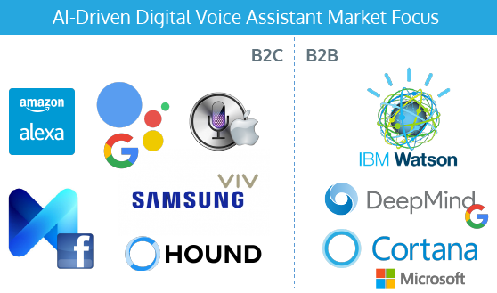
Amazon Alexa VS IBM Watson
Amazon Alexa and IBM Watson Won The 2016 Voice Assistant Wars and Are Already Winning 2017

Slide 5
Amazon Alexa VS IBM Watson
Amazon was the clear B2C winner. No one else was close.
IBM’s Watson has traction with B2B end users and partners at a scale and scope that no other company currently matches.

Slide 6
IBM need the same product
The market just formed. Everybody want shares from this market
Since IBM won the B2B wars, IBM should have the matching product to occupy the matching market shares

Slide 7
Current Market Products
Amazon Alexa (B2C)

Slide 8
B2C
Google

Slide 9
B2C
Facebook

Slide 10
B2B
IBM

Slide 11
B2B
Google DeepMind

Slide 12
B2B
Microsoft

Slide 13
Watson app
针对的市场
Tim Hortons, MacDonald, Pizza Pizza, Pop Eyes, Wendys, Buger King, Walmart, The Bay, Costco…
具体分析Tim Hortons 的咖啡市场情况
$2.2/ 1.13 = $1.94
然后再减掉材料成本，人工，店面租金， 加盟费

Slide 14
Watson app
重要性
必要性
紧迫性

